Slide 1
Analog Electronic Circuits
Quadrature Down Converter Final Presentation

Slide 2
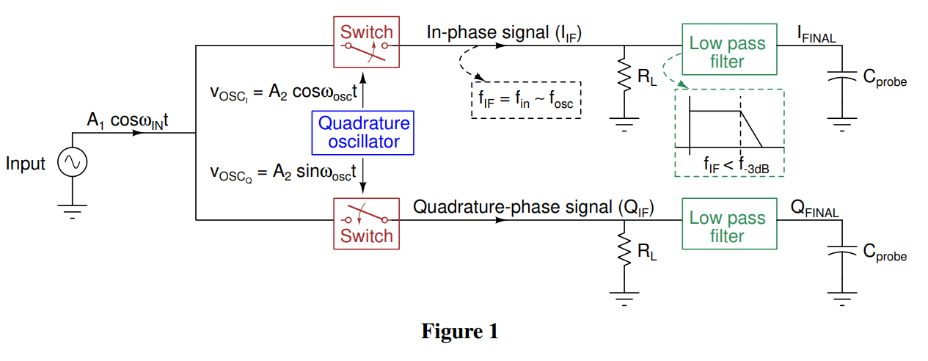
Quadrature Down Converter →
Block Diagram

Slide 3
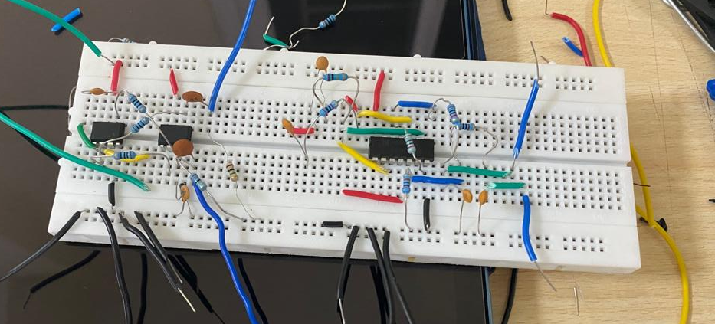
Complete Circuit
Hardware Implementation:

Slide 4
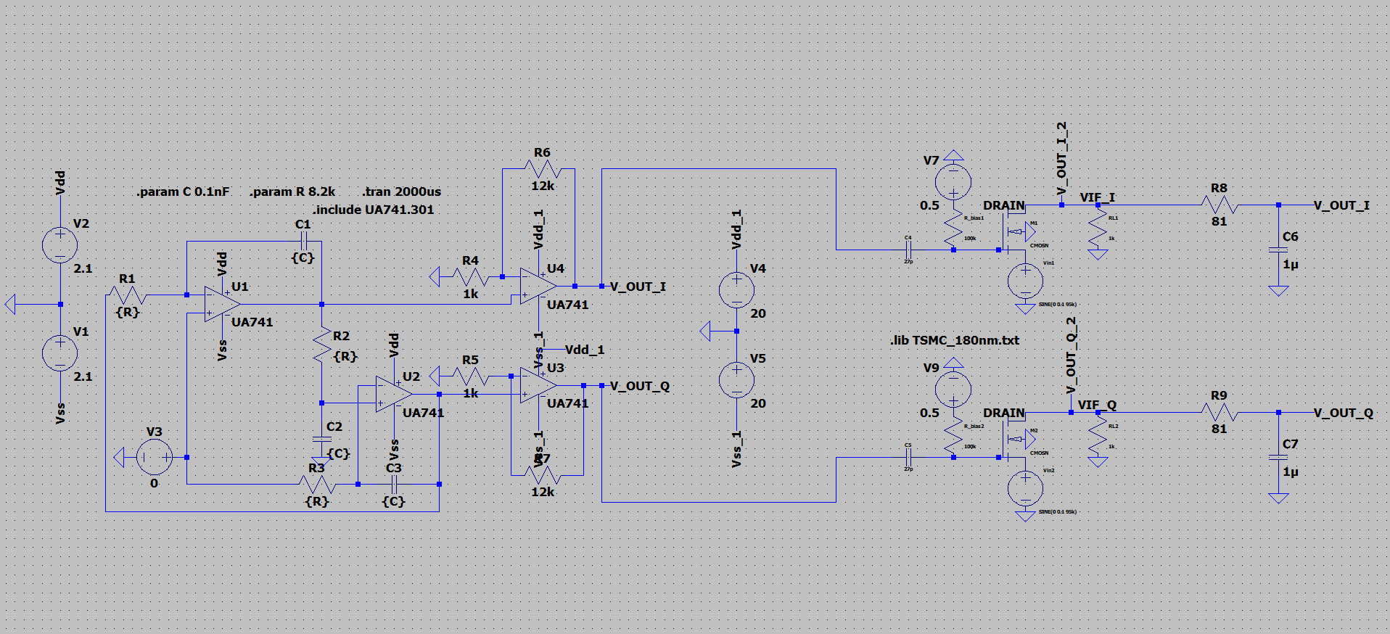
Complete Circuit
LTSpice Simulation:

Slide 5
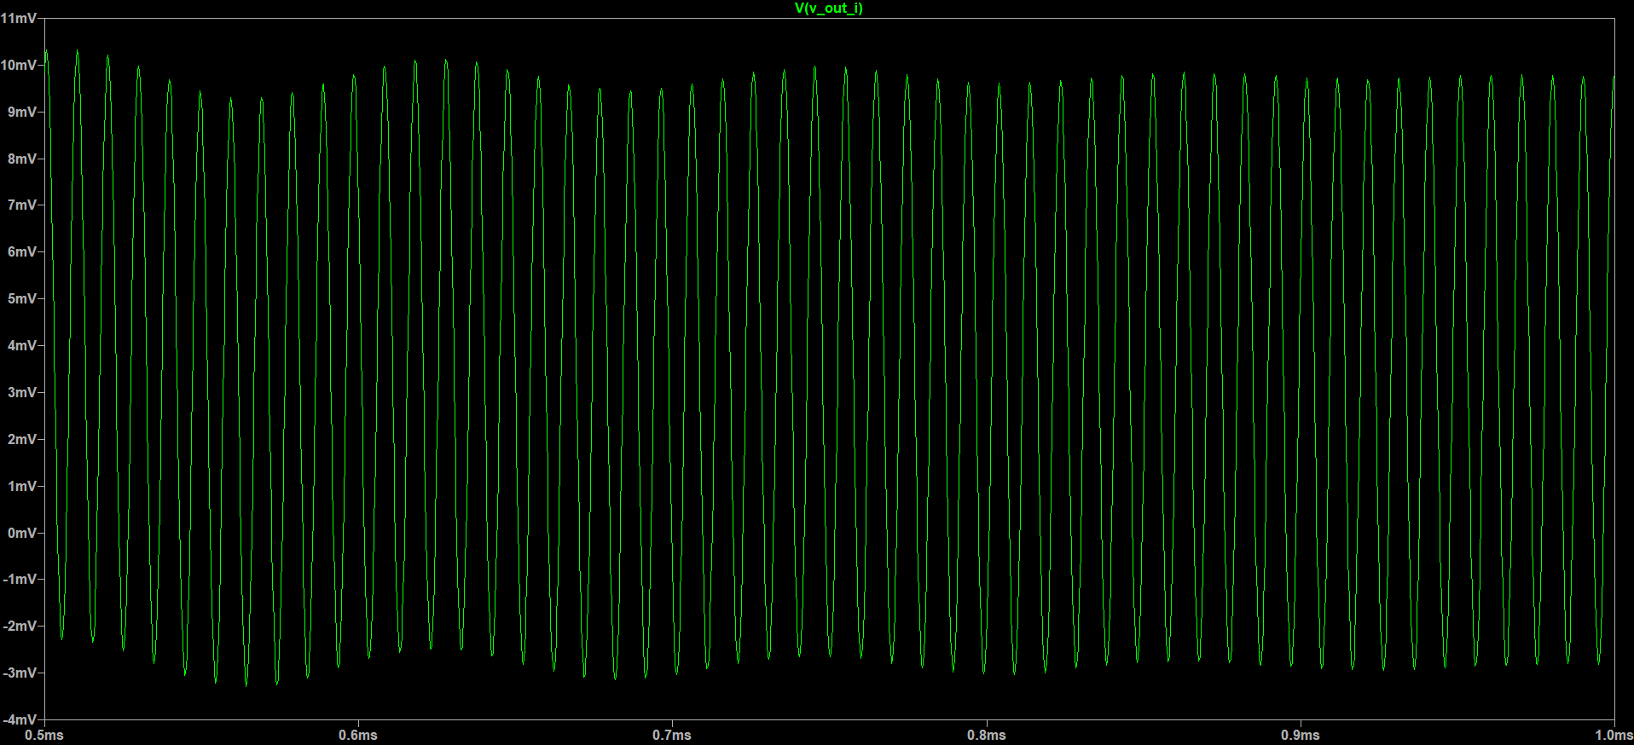
Complete Circuit
Final LTSpice Output, in-phase component →

Slide 6
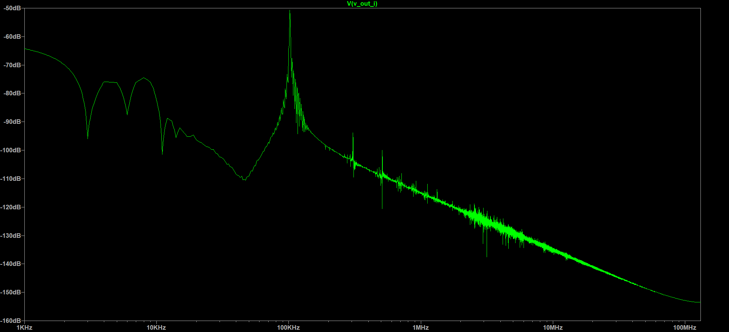
Complete Circuit
Final LTSpice Output, in-phase component FFT →

Slide 7
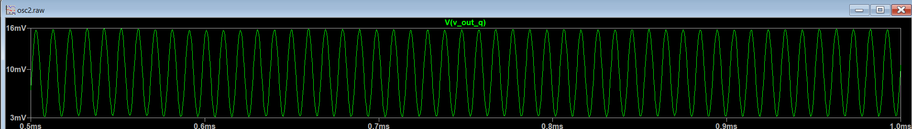
Complete Circuit
Final LTSpice Output, Quadrature-phase component →

Slide 8
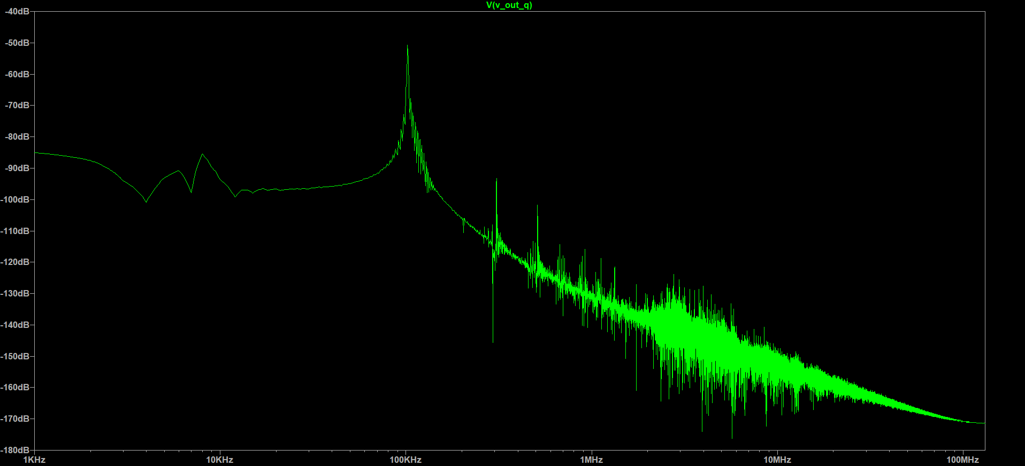
Complete Circuit
Final LTSpice Output, Quadrature-phase FFT→

Slide 9
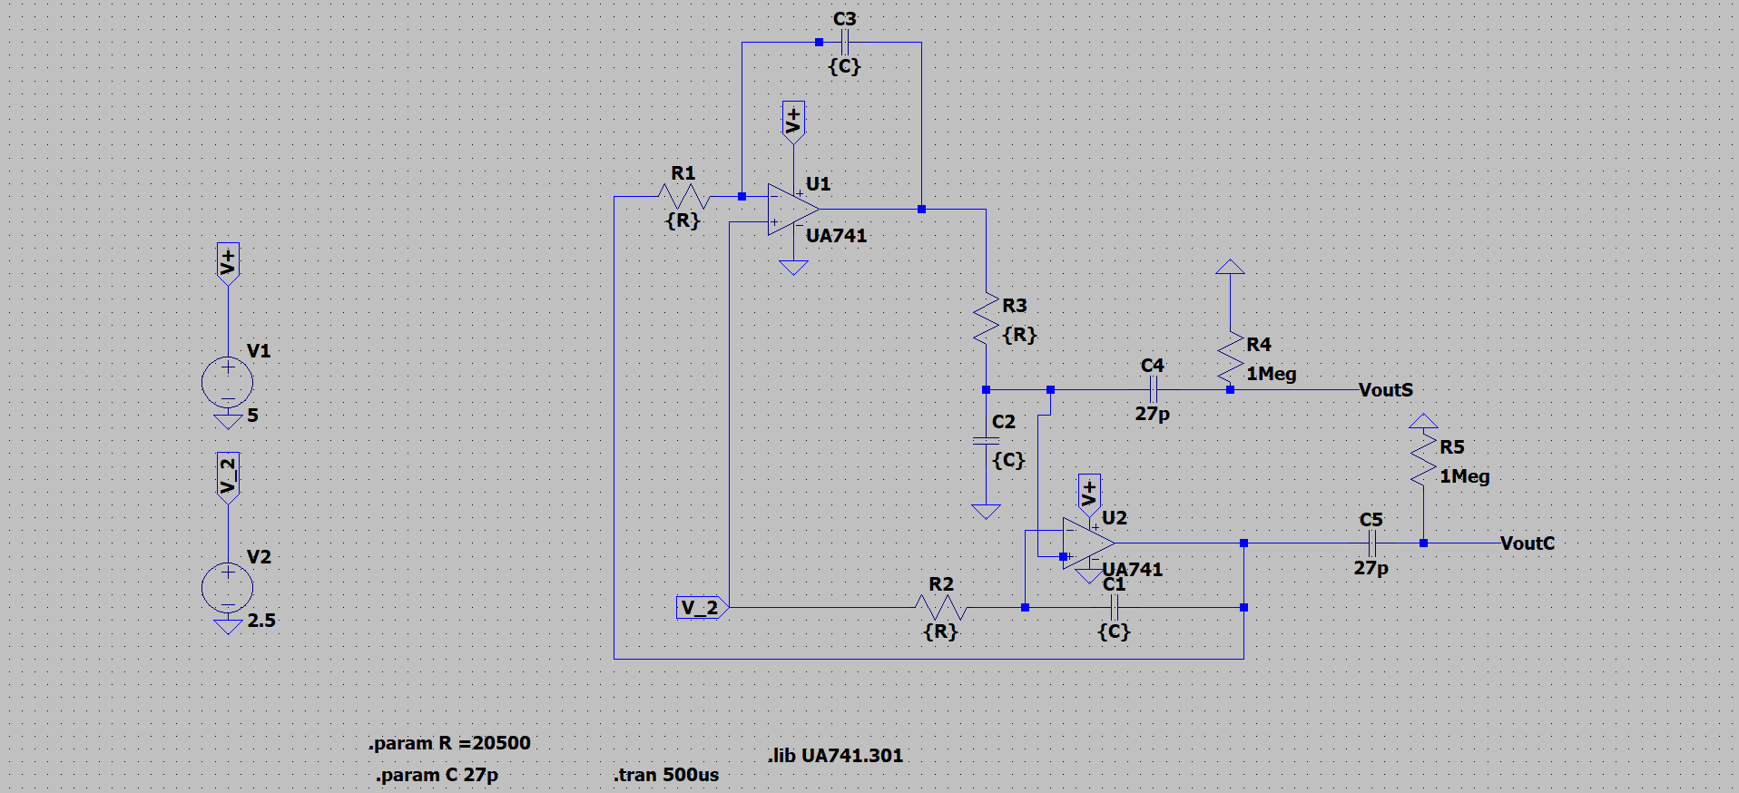
Quadrature Down Oscillator
LTSpice Circuit:

Slide 10
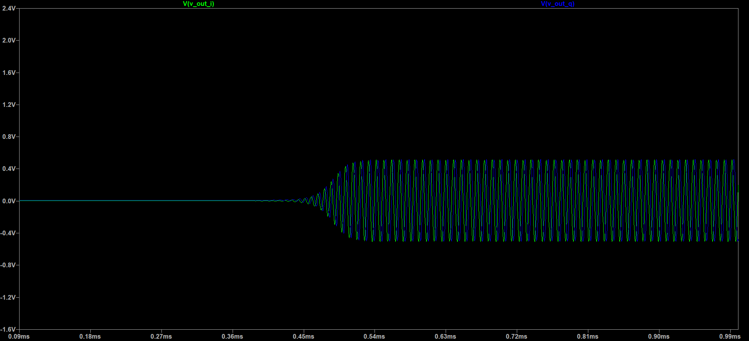
LTSpice Output Plot for Quadrature:

Slide 11
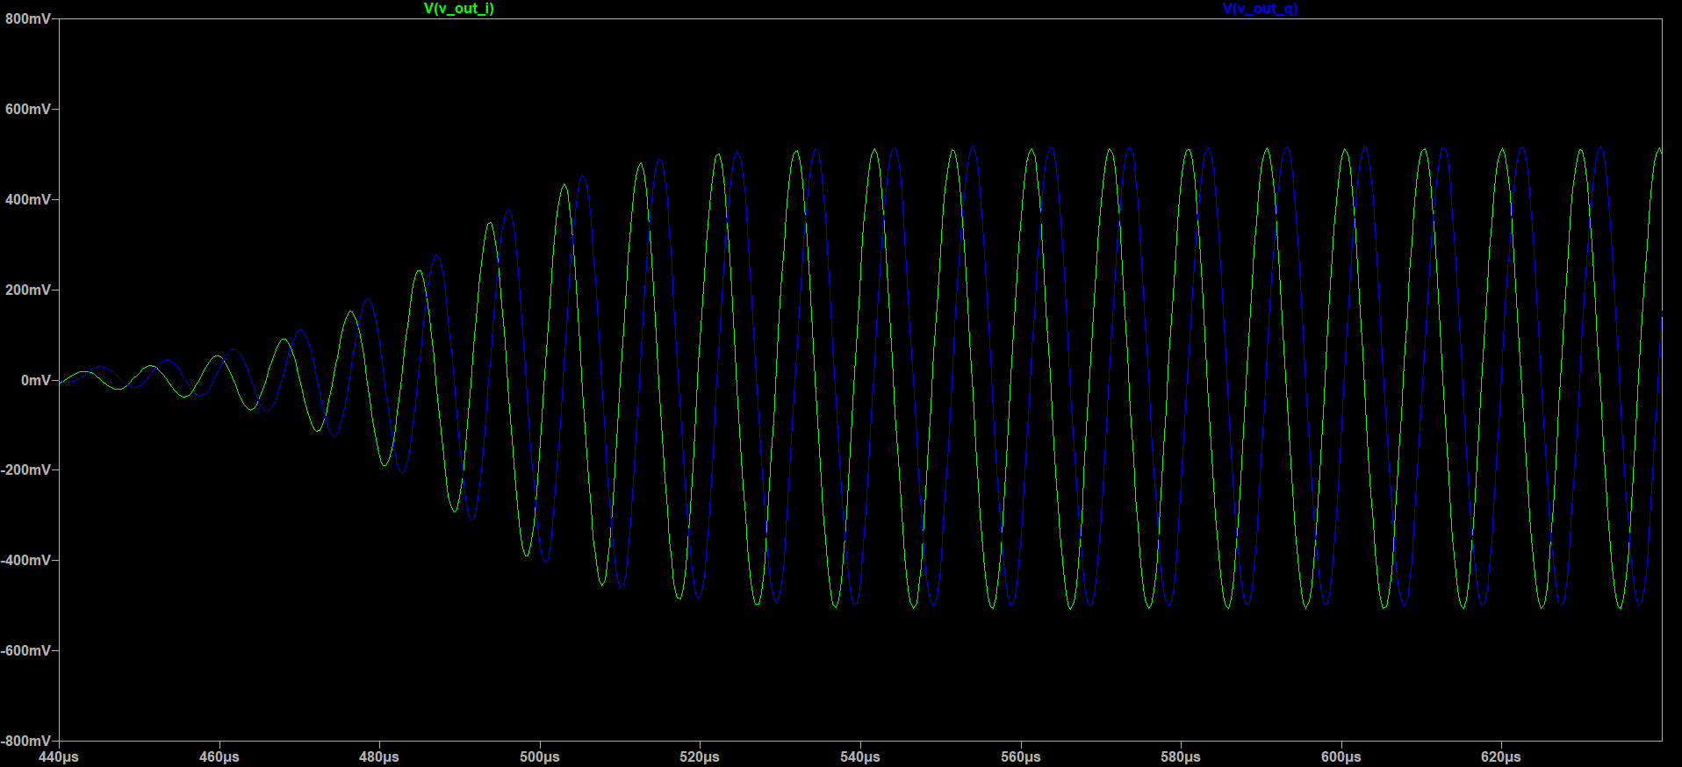
LTSpice Output Plot:

Slide 12
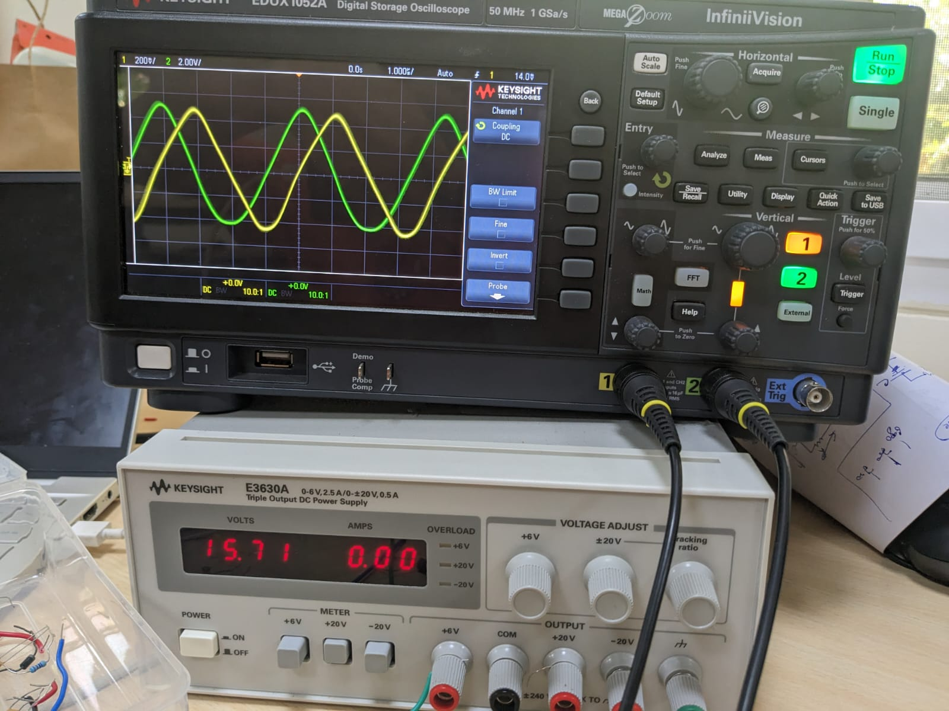
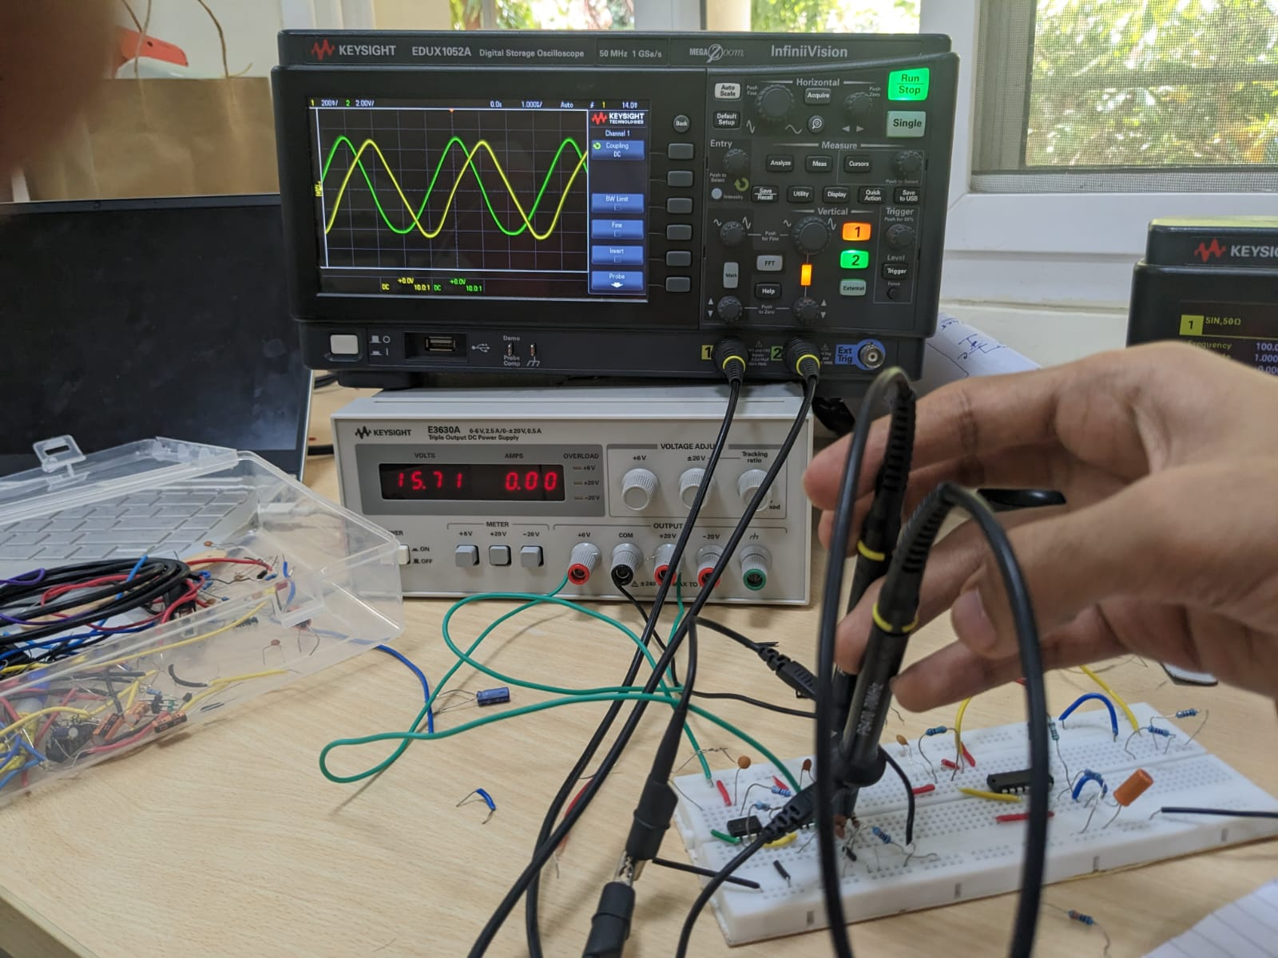
Hardware Results of Quadrature Oscilloscope:

Slide 13
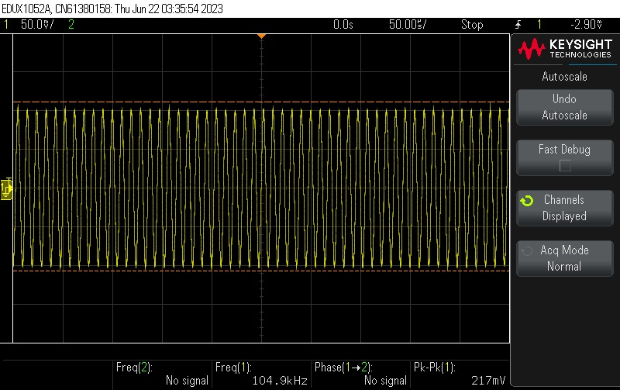
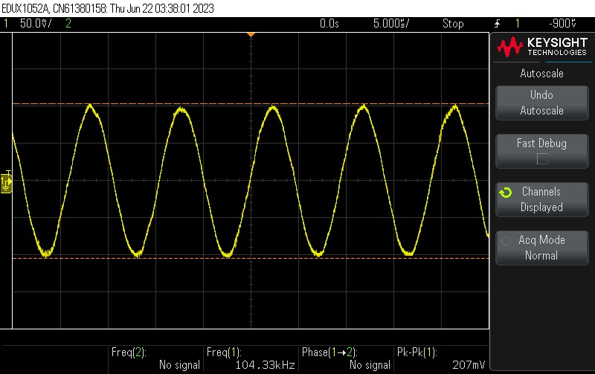
Hardware Results of Quadrature Oscilloscope: (We were getting a little higher value of frequency)

Slide 14
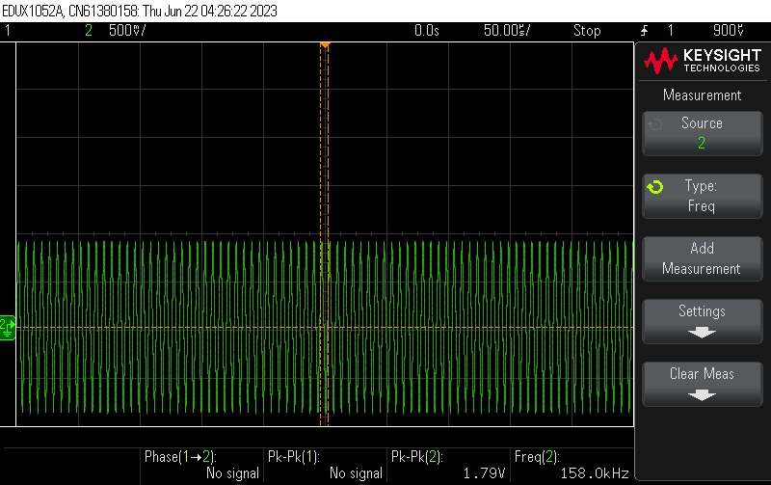
Hardware Results of Quadrature Oscilloscope:

Slide 15
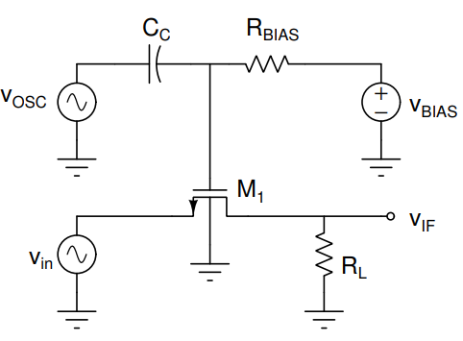
Mixer Switch →
Circuit Schematic:

Slide 16
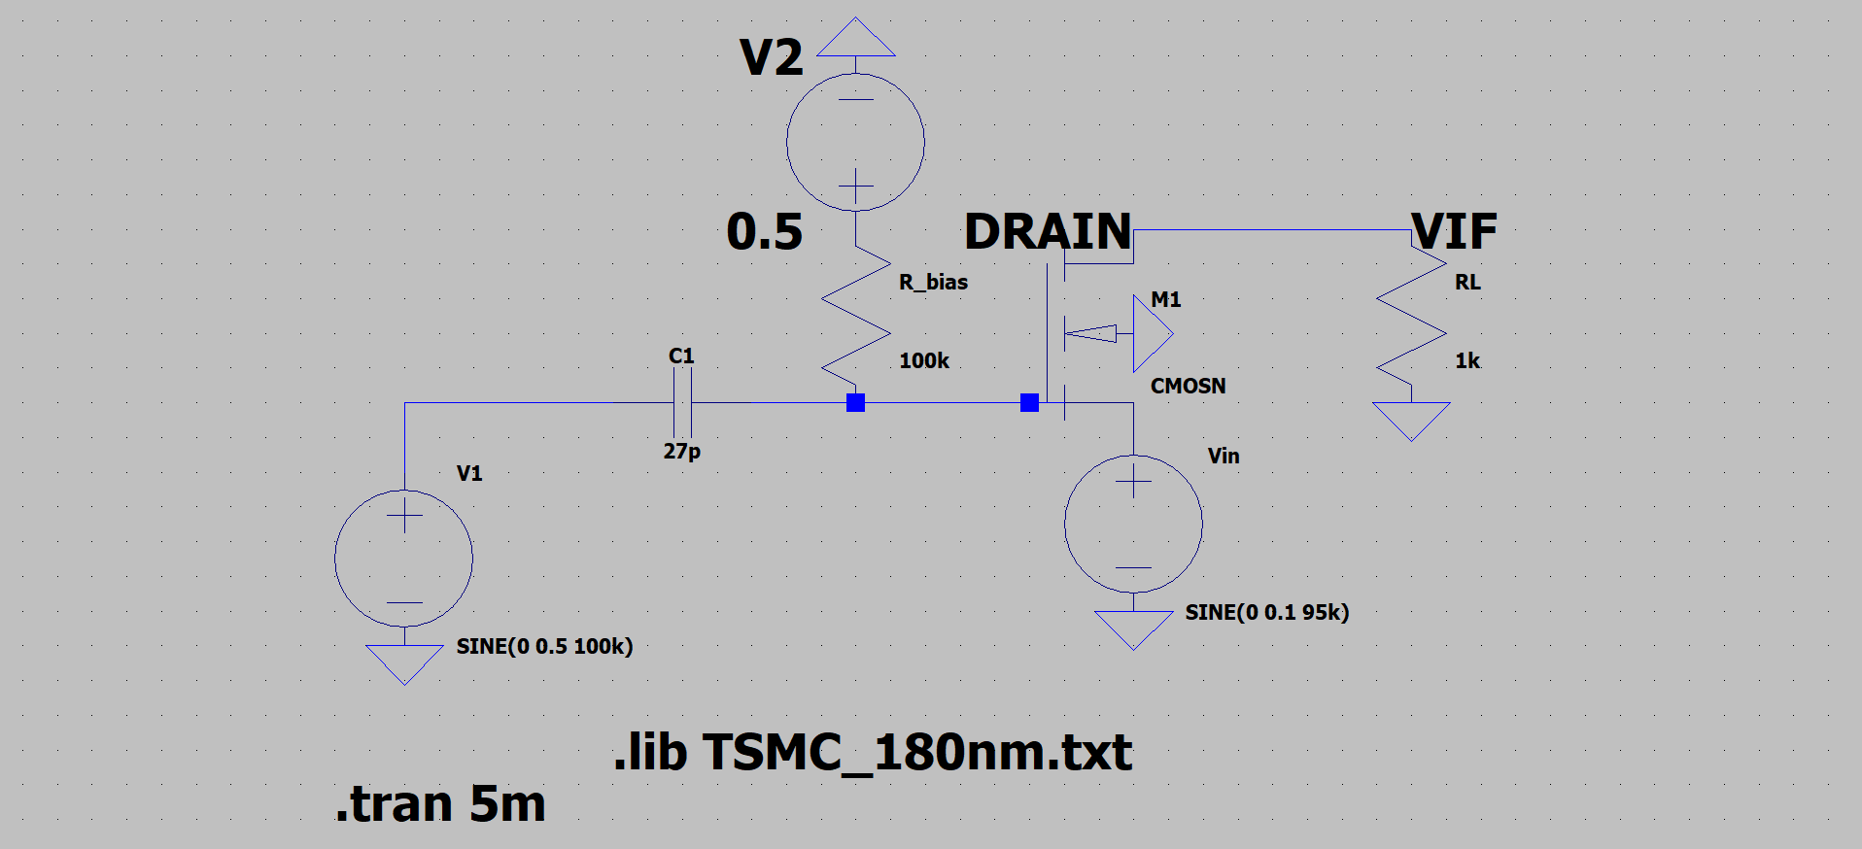
Mixer Switch: LTSpice Implementation

Slide 17
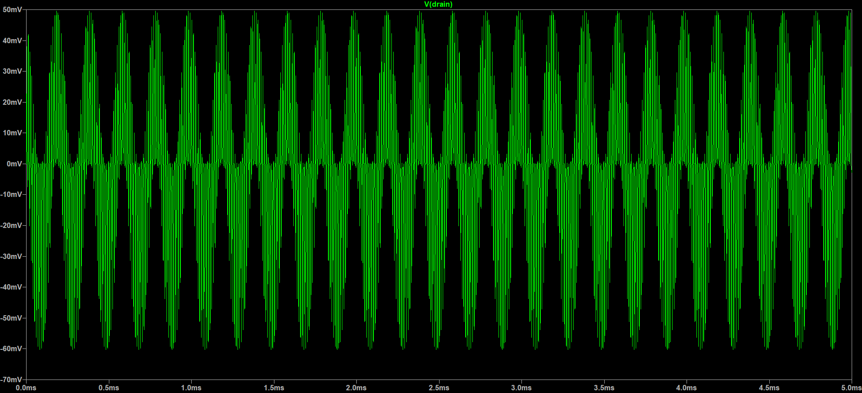
Mixer Switch: LTSpice Output

Slide 18
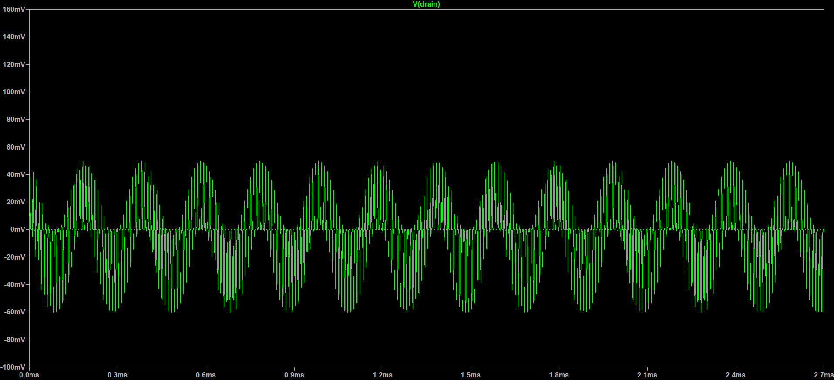
Mixer Switch: LTSpice Output

Slide 19
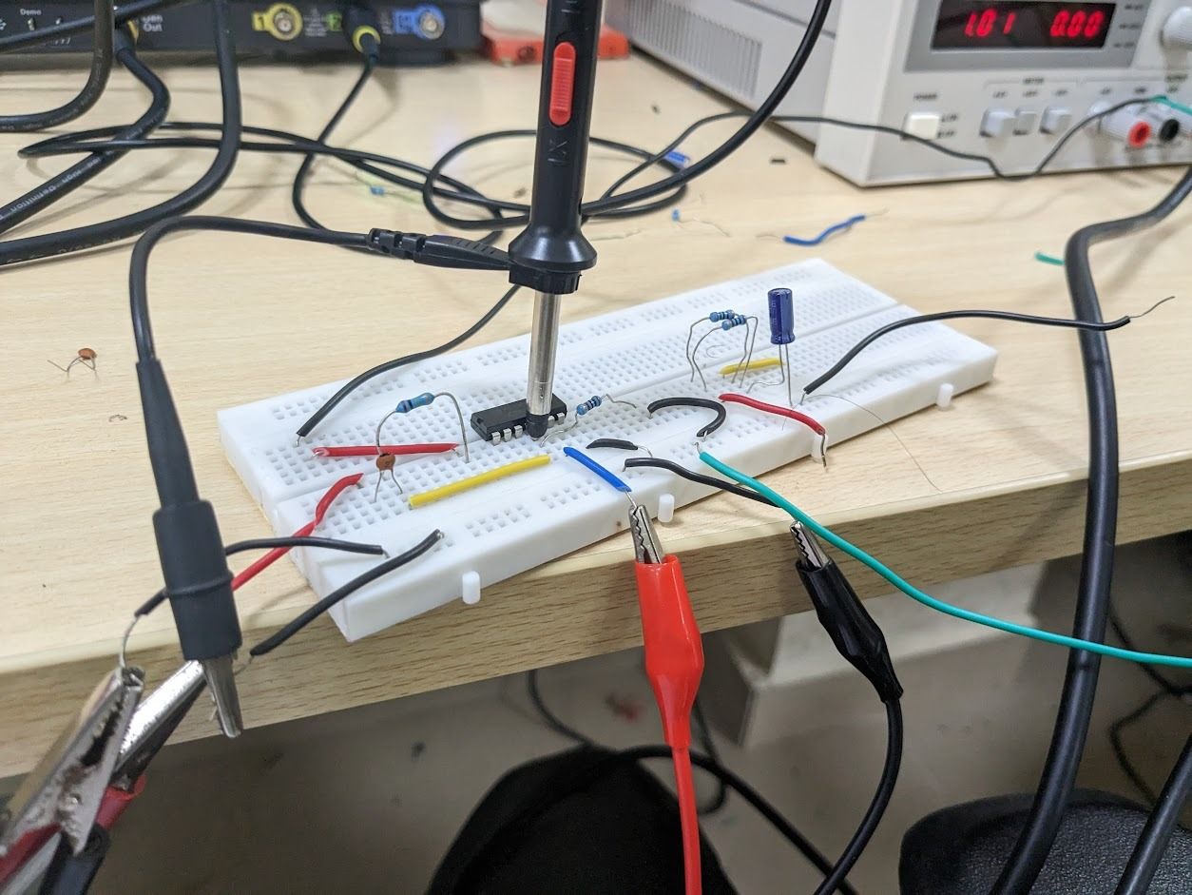
Mixer Switch: Hardware Implementation

Slide 20
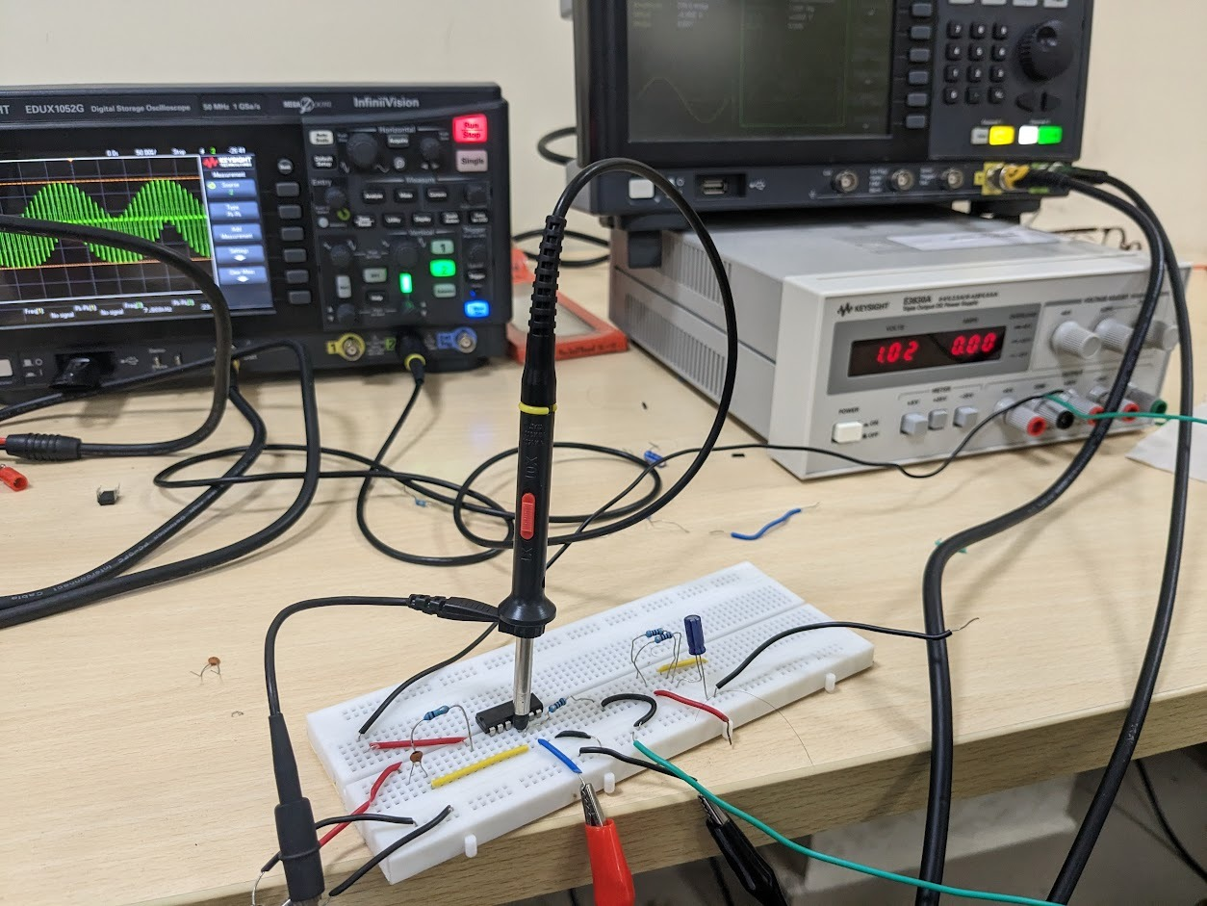
Mixer Switch: Hardware Implementation

Slide 21
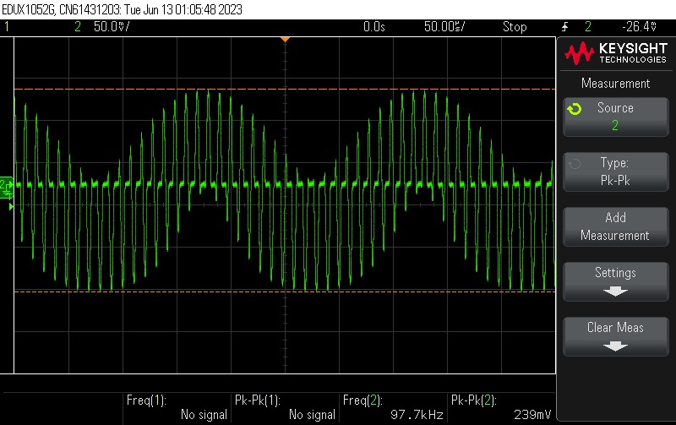
Mixer Switch: Hardware Output

Slide 22
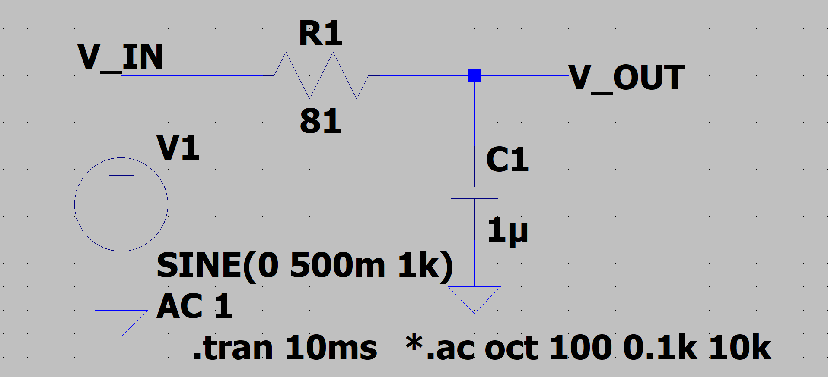
Low Pass Filter: LTSpice Circuit

Slide 23
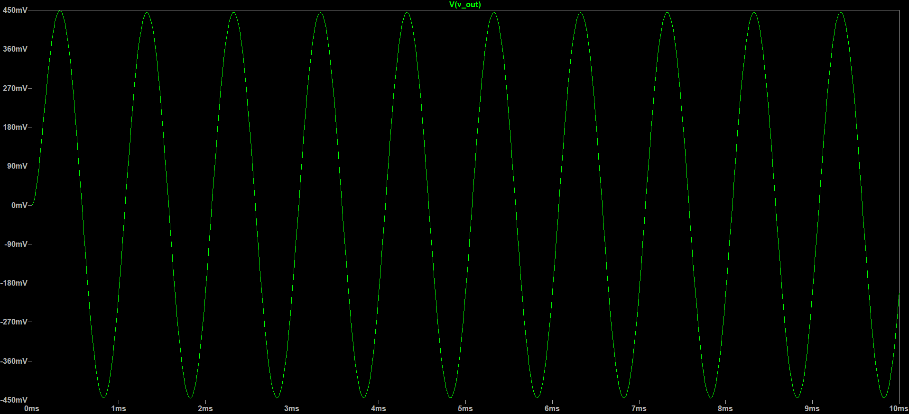
Low Pass Filter: LTSpice Output: Transient Response for 1KHz Input signal

Slide 24
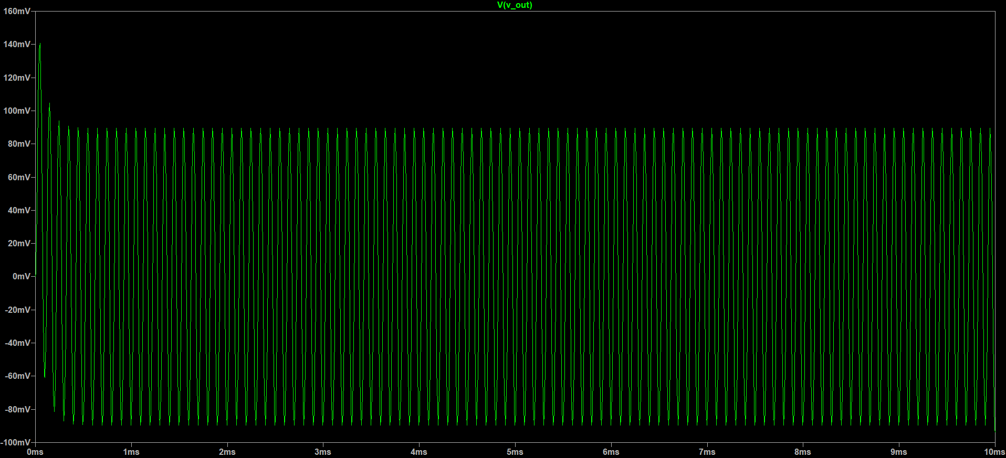
Low Pass Filter: LTSpice Output: Transient Response for 10KHz Input signal

Slide 25
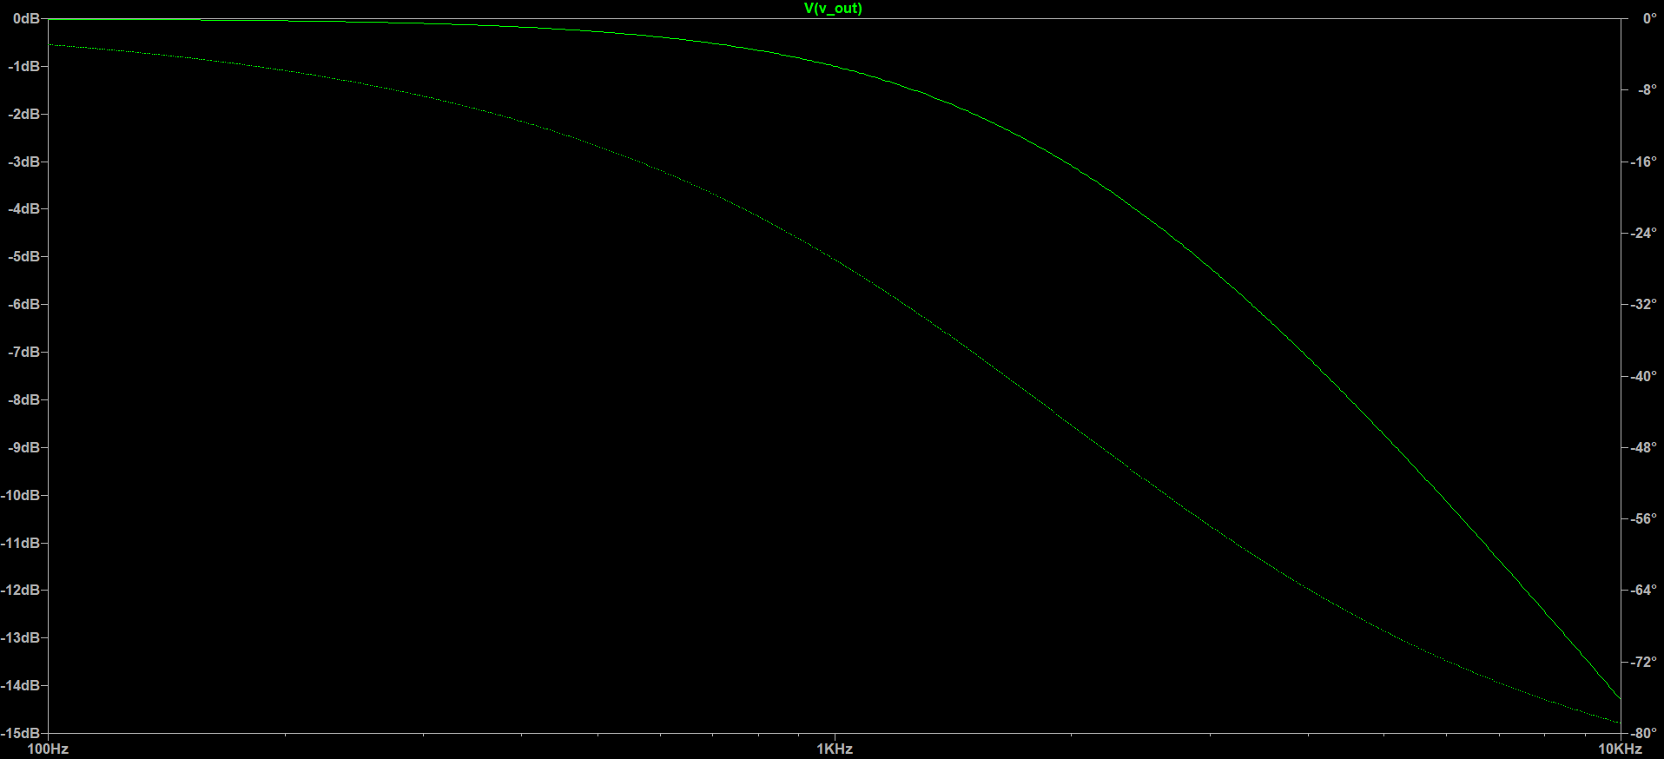
Low Pass Filter: LTSpice Output: Frequency Response

Slide 26
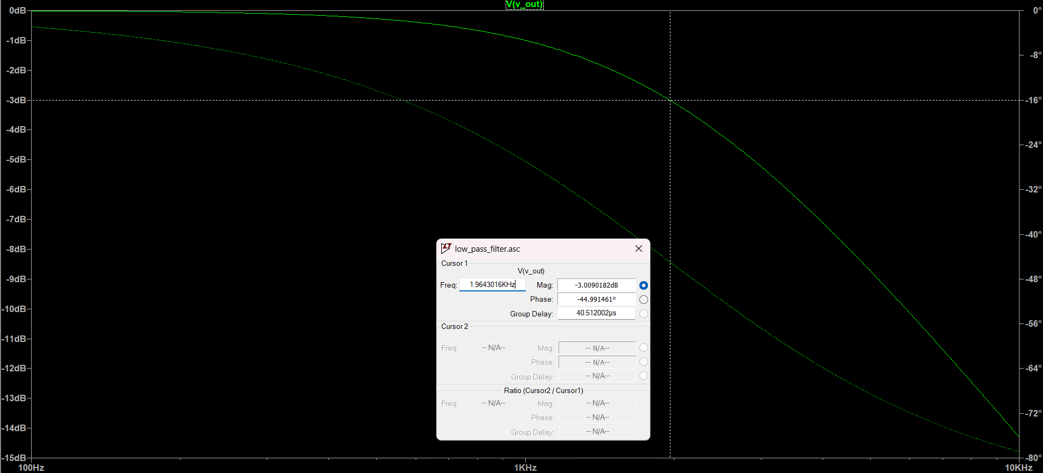
Low Pass Filter: LTSpice Output: Frequency Response → -3dB Cutoff = 2kHz

Slide 27
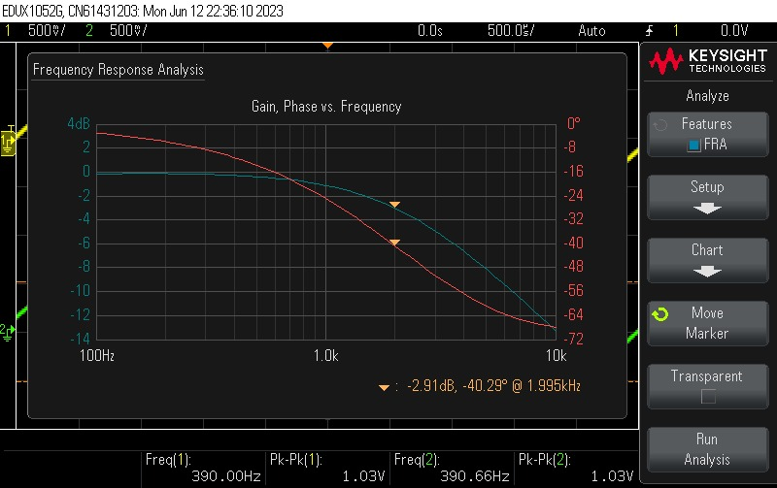
Low Pass Filter, Hardware Result:

Slide 28
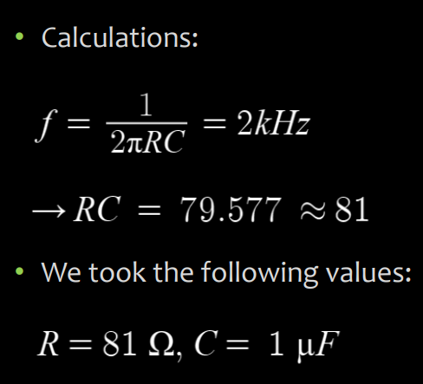
Low Pass Filter: Calculations

